Slide 2
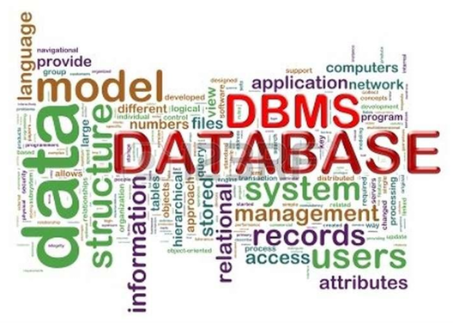
Database Systems: Design, Implementation, and Management Ninth Edition
Chapter 1
Database Concept
Database Systems, 9th Edition
‹#›

Slide 3
OBJECTIVES
In this chapter, you will learn:
The difference between data and information
What a database is, the various types of databases, and why they are valuable assets for decision making
The importance of database design
How modern databases evolved from file systems
About flaws in file system data management
The main components of the database system
The main functions of a database management system (DBMS)
Database Systems, 9th Edition
‹#›
Notes:
‹#›

Slide 4
WHY DATABASES?
Databases solve many of the problems encountered in data management
Used in almost all modern settings involving data management:
Business
Research
Administration
Important to understand how databases work and interact with other applications
Database Systems, 9th Edition
‹#›

Slide 5
DATA VS. INFORMATION
Data are raw facts
Information is the result of processing raw data to reveal meaning
Information requires context to reveal meaning
Raw data must be formatted for storage, processing, and presentation
Data are the foundation of information, which is the bedrock of knowledge
Database Systems, 9th Edition
‹#›
Notes:
Context transforms raw data into meaningful information by providing the background and circumstances needed for accurate interpretation and decision-making.
‹#›

Slide 6
DATA VS. INFORMATION (CONT’D.)
Data: building blocks of information
Information produced by processing data
Information used to reveal meaning in data
Accurate, relevant, timely information is the key to good decision making
Good decision making is the key to organizational survival
Database Systems, 9th Edition
‹#›

Slide 7
INTRODUCING THE DATABASE
Database: shared, integrated computer structure that stores a collection of:
End-user data: raw facts of interest to end user
Metadata: data about data
Provides description of data characteristics and relationships in data
Complements and expands value of data
Database management system (DBMS): collection of programs that manages structure and controls access to data
Database Systems, 9th Edition
‹#›

Slide 8

ROLE AND ADVANTAGES OF THE DBMS
DBMS is the intermediary between the user and the database
Database structure stored as file collection
Can only access files through the DBMS
DBMS enables data to be shared
DBMS integrates many users’ views of the data
Database Systems, 9th Edition
‹#›

Slide 9
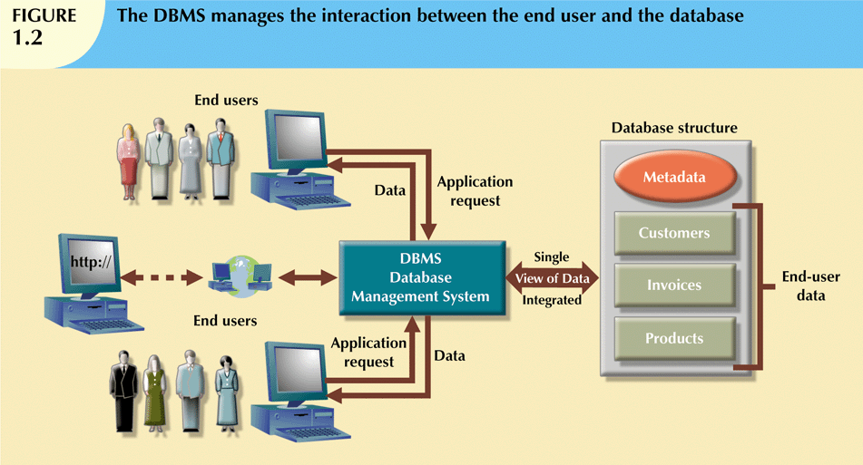
Database Systems, 9th Edition
‹#›

Slide 10
ROLE AND ADVANTAGES OF THE DBMS
Advantages of a DBMS:
Improved data sharing
Improved data security
Better data integration
Minimized data inconsistency
Improved data access
Improved decision making
Increased end-user productivity
Database Systems, 9th Edition
‹#›

Slide 11
TYPES OF DATABASES
Databases can be classified according to:
Number of users
Database location(s)
Expected type and extent of use
Single-user database supports only one user at a time
Desktop database: single-user; runs on PC
Multiuser database supports multiple users at the same time
Workgroup and enterprise databases
Database Systems, 9th Edition
‹#›
Notes:
‹#›

Slide 12

TYPES OF DATABASES (CONT’D.)
Centralized database: data located at a single site
Distributed database: data distributed across several different sites
Operational database: supports a company’s day-to-day operations
Transactional or production database
Designed to allow users to easily define, modify, retrieve and manage data in real-time
Data warehouse: stores data used for tactical or strategic decisions
Database Systems, 9th Edition
‹#›
Notes:
A data warehouse is a centralized repository that collects, integrates, and stores large volumes of historical data from multiple sources within an organization. It is designed to support business intelligence (BI), reporting, analytics, and decision-making.
‹#›

Slide 13
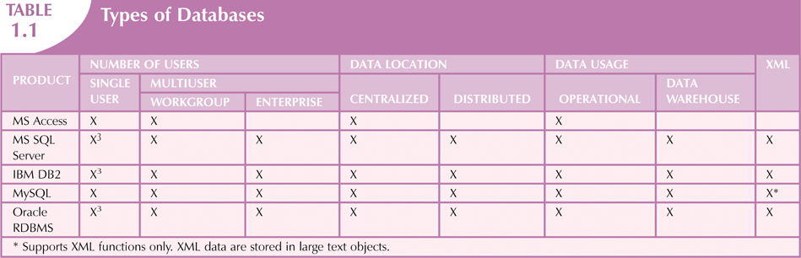
Database Systems, 9th Edition
‹#›
Notes:
XML (eXtensible Markup Language) data is a self-describing, structured format used to store and exchange information between different systems and applications.
Data exchange between applications Web services and APIs
Integration of information from different systems
‹#›

Slide 14
WHY DATABASE DESIGN IS IMPORTANT
Database design focuses on design of database structure used for end-user data
Designer must identify database’s expected use
Well-designed database:
Facilitates data management
Generates accurate and valuable information
Poorly designed database:
Causes difficult-to-trace errors
Database Systems, 9th Edition
‹#›

Slide 15
EVOLUTION OF FILE SYSTEM DATA PROCESSING
Reasons for studying file systems:
Complexity of database design is easier to understand
Understanding file system problems helps to avoid problems with DBMS systems
Knowledge of file system is useful for converting file system to database system
File systems typically composed of collection of file folders, each tagged and kept in cabinet
Database Systems, 9th Edition
‹#›

Slide 16
EVOLUTION OF FILE SYSTEM DATA PROCESSING (CONT'D.)
Contents of each file folder are logically related
Manual systems
Served as a data repository for small data collections
Cumbersome for large collections
Computerized file systems
Data processing (DP) specialist converted computer file structure from manual system
Database Systems, 9th Edition
‹#›

Slide 17
EVOLUTION OF FILE SYSTEM DATA PROCESSING (CONT'D.)
Initially, computer file systems resembled manual systems
As number of files increased, file systems evolved
Each file used its own application program to store, retrieve, and modify data
Each file was owned by individual or department that commissioned its creation
Database Systems, 9th Edition
‹#›

Slide 18
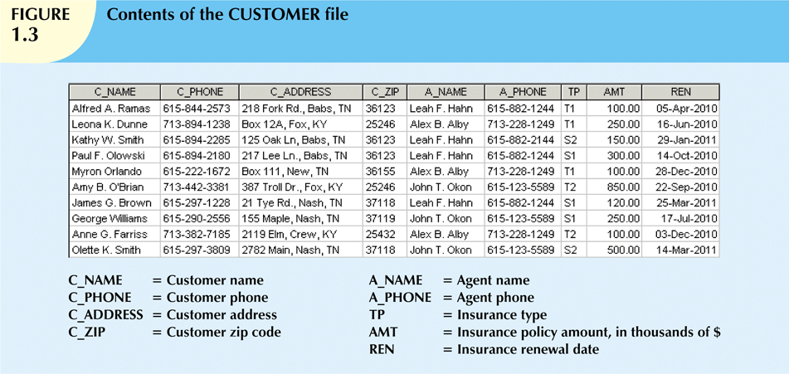
Database Systems, 9th Edition
‹#›

Slide 19
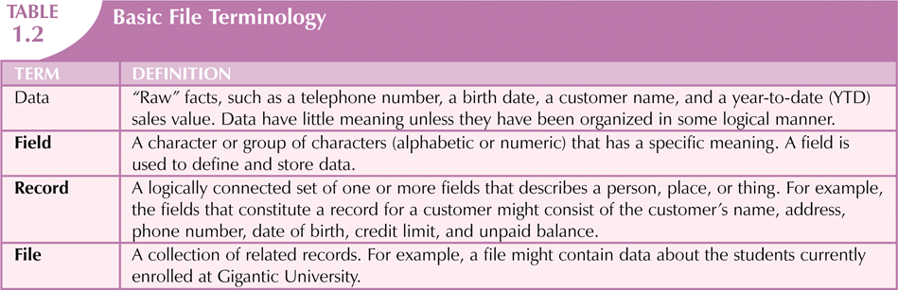
Database Systems, 9th Edition
‹#›

Slide 20
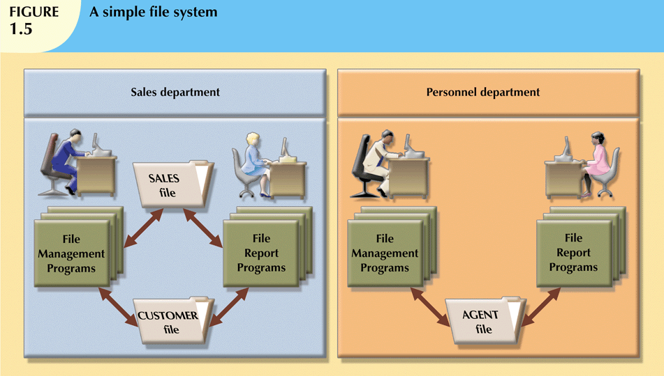
Database Systems, 9th Edition
‹#›

Slide 21
PROBLEMS WITH FILE SYSTEM DATA PROCESSING
File systems were an improvement over manual system
File systems used for more than two decades
Understanding the shortcomings of file systems aids in development of modern databases
Many problems not unique to file systems
Even simple file system retrieval task required extensive programming
Ad hoc queries impossible
Changing existing structure difficult
Database Systems, 9th Edition
‹#›
Notes:
Ad hoc query refers to user-defined searches that are used to gain insight into a given data set without requiring any predefined dashboards, drill paths, and coding.
By leveraging these types of queries, users can access specific information when and where they need it.

Slide 22
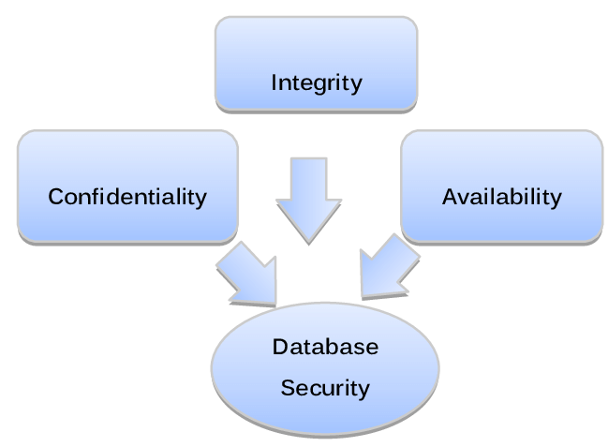
PROBLEMS WITH FILE SYSTEM DATA PROCESSING (CONT'D.)
Security features difficult to program
Often omitted in file system environments
Summary of file system limitations:
Requires extensive programming
Cannot perform ad hoc queries
System administration is complex and difficult
Difficult to make changes to existing structures
Security features are likely to be inadequate
Database Systems, 9th Edition
‹#›

Slide 23
STRUCTURAL AND DATA DEPENDENCE
Structural dependence: access to a file is dependent on its own structure (changes will cause changing all structure)
All file system programs must be modified to conform to a new file structure
Structural independence: change file structure without affecting data access
Data dependence: data access changes when data storage characteristics change (affecting data access)
Data independence: data storage characteristics do not affect data access
Database Systems, 9th Edition
‹#›

Slide 24
DATA REDUNDANCY
File system structure makes it difficult to combine data from multiple sources
Vulnerable to security breaches
Organizational structure promotes storage of same data in different locations
Islands of information
Data stored in different locations is unlikely to be updated consistently
Data redundancy: same data stored unnecessarily in different places
Database Systems, 9th Edition
‹#›

Slide 25
DATA REDUNDANCY (CONT'D.)
Data inconsistency: different and conflicting versions of same data occur at different places
Data anomalies: abnormalities when all changes in redundant data are not made correctly (changes made will cause unexpected result)
Three types of anomalies:
Update anomalies
Insertion anomalies
Deletion anomalies
Database Systems, 9th Edition
‹#›

Slide 26
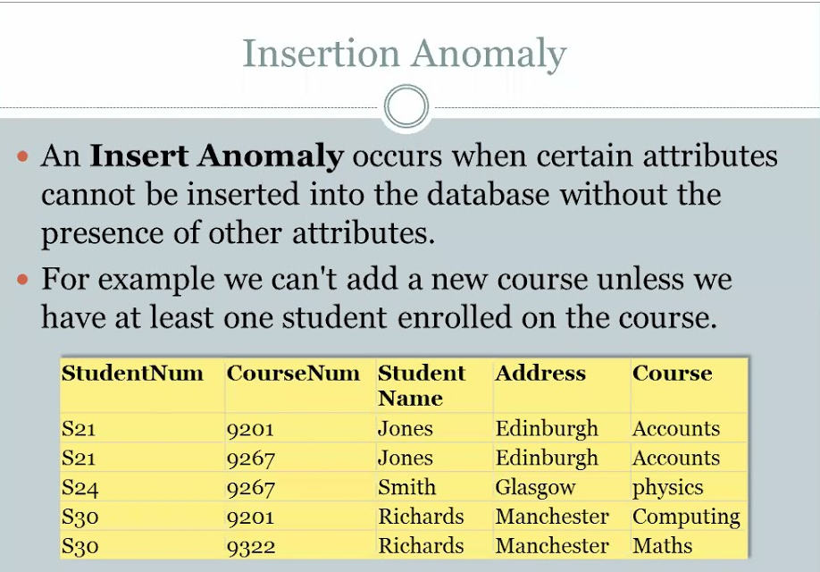
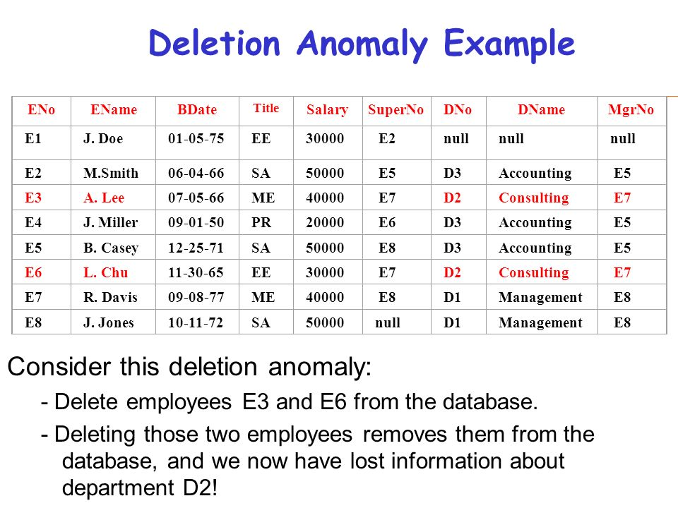
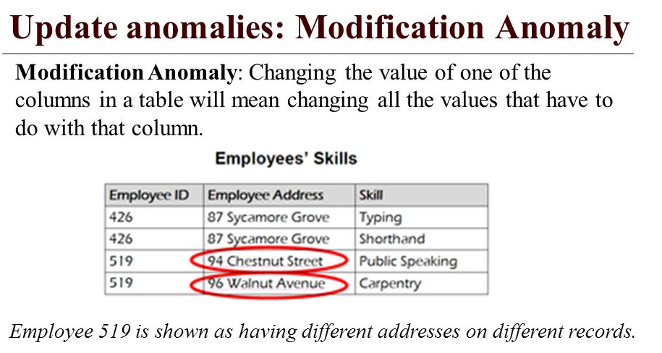

Slide 27
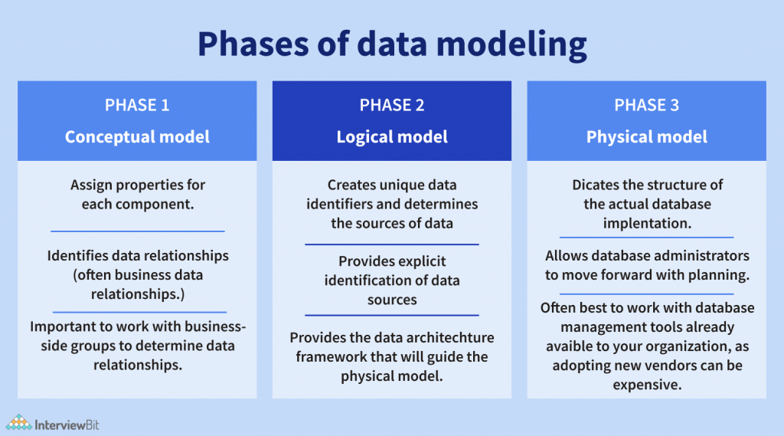
Notes:
Conceptual Model-Business view of data, Entities and relationships
Logical Model-Detailed data structure-Tables, attributes, keys
Physical Model-Database implementation Actual database schema
‹#›

Slide 28
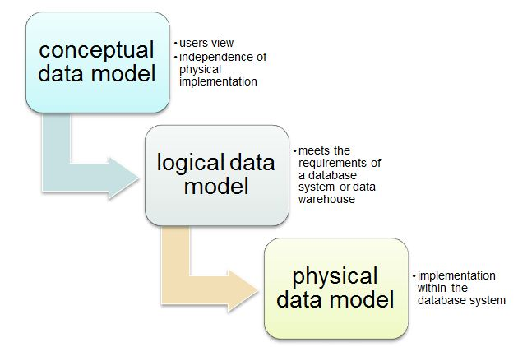
LACK OF DESIGN AND DATA-MODELING SKILLS
Most users lack the skill to properly design databases, despite multiple personal productivity tools being available
Data-modeling skills are vital in the data design process
Good data modeling facilitates communication between the designer, user, and the developer
Database Systems, 9th Edition
‹#›
Notes:
The Conceptual Model Is To Establish The Entities, Their Attributes, And Their Relationships. [basic ERD]
The Logical Data Model Defines The Structure Of The Data Elements And Set The Relationships Between Them. [define ERD, define PK]
The Physical Data Model Describes The Database-Specific Implementation Of The Data Model. [detail ERD as real situation]
‹#›

Slide 29
DATABASE SYSTEMS
Database system consists of logically related data stored in a single logical data repository
May be physically distributed among multiple storage facilities
DBMS eliminates most of file system’s problems
Current generation stores data structures, relationships between structures, and access paths
Also defines, stores, and manages all access paths and components
Database Systems, 9th Edition
‹#›
Notes:
data repository:
A data repository is a data storage entity in which data has been isolated for analytical or reporting purposes. Since it provides long-term storage and access to data, it is a type of sustainable information infrastructure.
‹#›

Slide 30
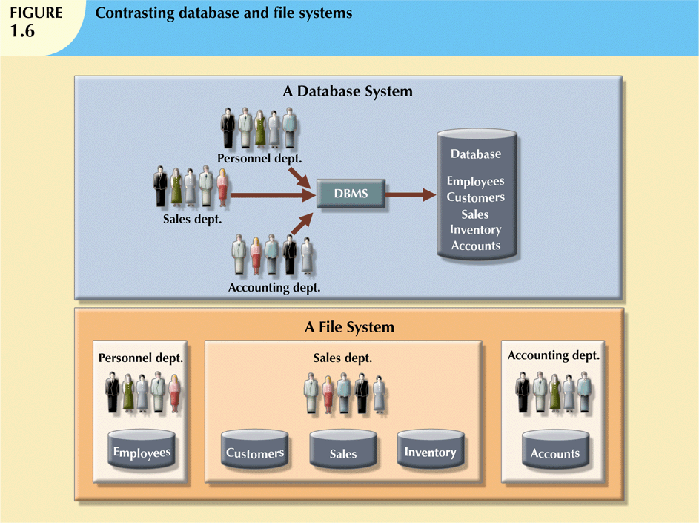
Database Systems, 9th Edition
‹#›

Slide 31
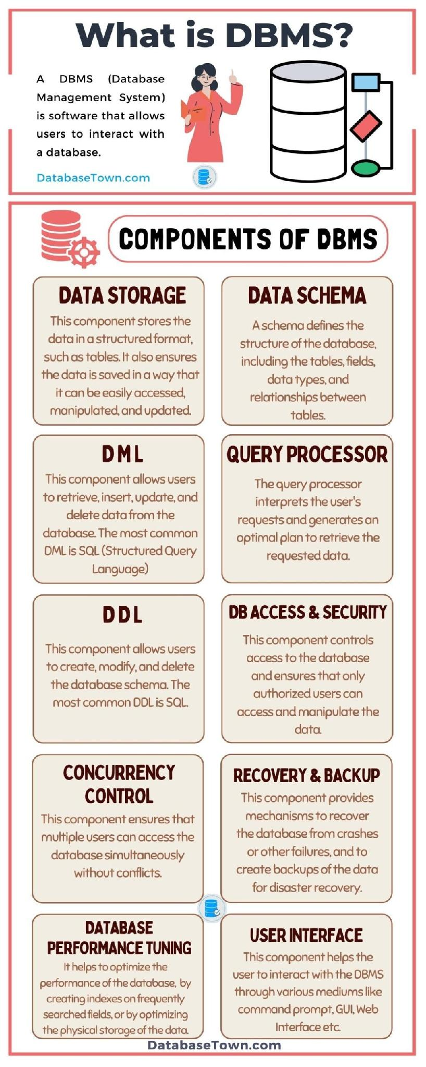
A DBMS is a software that allows users to interact with database.
Database Systems, 9th Edition
‹#›
Notes:
‹#›

Slide 32
THE DATABASE SYSTEM ENVIRONMENT
Database system: defines and regulates the collection, storage, management, use of data
Five major parts of a database system:
Hardware
Software
People
Procedures
Data
Database Systems, 9th Edition
‹#›

Slide 33
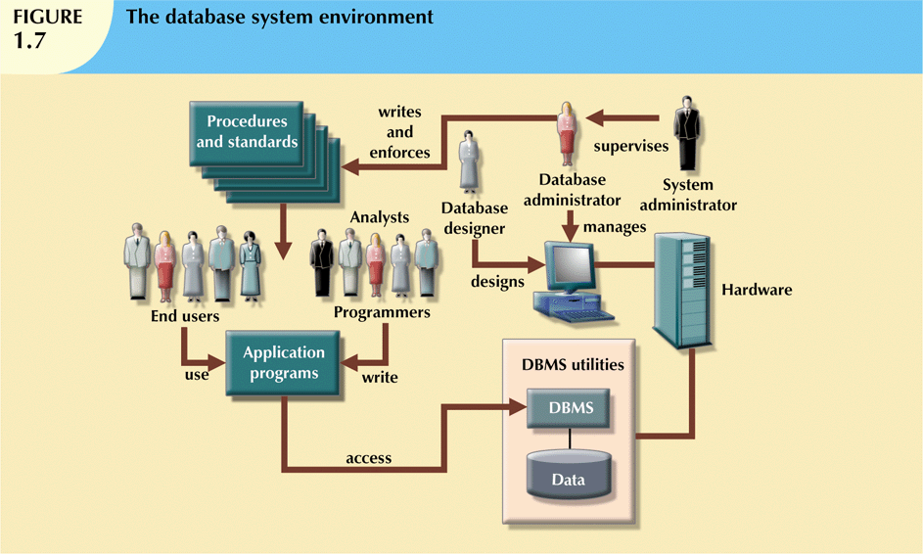
Database Systems, 9th Edition
‹#›

Slide 34
THE DATABASE SYSTEM ENVIRONMENT
Hardware: all the system’s physical devices
Software: three types of software required:
Operating system software
DBMS software
Application programs and utility software
People: all users of the database system
System and database administrators
Database designers
Systems analysts and programmers
End users
Procedures: instructions and rules that govern the design and use of the database system
Data: the collection of facts stored in the database
Hardware: all the system’s physical devices
Software: three types of software required:
Operating system software
DBMS software
Application programs and utility software
People: all users of the database system
System and database administrators
Database designers
Systems analysts and programmers
End users
Procedures: instructions and rules that govern the design and use of the database system
Data: the collection of facts stored in the database
Database Systems, 9th Edition
‹#›

Slide 35
DBMS FUNCTIONS
Most functions are transparent to end users
Can only be achieved through the DBMS
Data dictionary management
DBMS stores definitions of data elements and relationships (metadata) in a data dictionary
DBMS looks up required data component structures and relationships
Changes automatically recorded in the dictionary
DBMS provides data abstraction and removes structural and data dependency
Database Systems, 9th Edition
‹#›

Slide 36
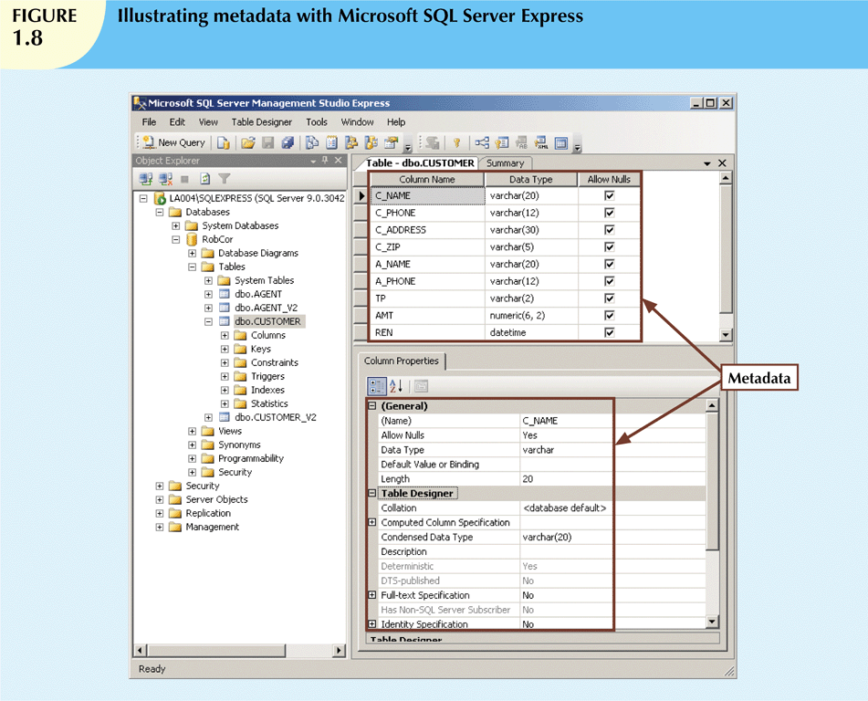
Database Systems, 9th Edition
‹#›

Slide 37
DBMS FUNCTIONS (CONT'D.)
Data storage management
DBMS creates and manages complex structures required for data storage
Also stores related data entry forms, screen definitions, report definitions, etc.
Performance tuning: activities that make the database perform more efficiently
DBMS stores the database in multiple physical data files
Database Systems, 9th Edition
‹#›

Slide 38
DBMS FUNCTIONS (CONT'D.)
Data transformation and presentation
DBMS transforms data entered to conform to required data structures
DBMS transforms physically retrieved data to conform to user’s logical expectations
Security management
DBMS creates a security system that enforces user security and data privacy
Security rules determine which users can access the database, which items can be accessed, etc.
Multiuser access control
DBMS uses sophisticated algorithms to ensure concurrent access does not affect integrity
Backup and recovery management
DBMS provides backup and data recovery to ensure data safety and integrity
Recovery management deals with recovery of database after a failure
Database Systems, 9th Edition
‹#›
Notes:
‹#›

Slide 39
DBMS FUNCTIONS (CONT'D.)
Data integrity management
DBMS promotes and enforces integrity rules
Minimizes redundancy
Maximizes consistency
Data relationships stored in data dictionary used to enforce data integrity
Integrity is especially important in transaction-oriented database systems
Database access languages and application programming interfaces
DBMS provides access through a query language
Query language is a nonprocedural language
Structured Query Language (SQL) is the de facto query language
Standard supported by majority of DBMS vendors
Database Systems, 9th Edition
‹#›
Notes:
Data Integrity
Data integrity ensures the quality and the reliability of the data of a database system.
Data integrity includes also the protection of the database from unauthorized access (confidentiality) and unauthorized changes. .
A DBMS should bring only correct and consistent data into the database.
Additionally, correct transactions ensure that the consistency is maintained during the operation of the system.
An example for inconsistency would be if contradictory statements were saved in the same database.
‹#›

Slide 40
MANAGING THE DATABASE SYSTEM: A SHIFT IN FOCUS
Database system provides a framework in which strict procedures and standards enforced
Role of human changes from programming to managing organization’s resources
Database system enables more sophisticated use of the data
Data structures created within the database and their relationships determine effectiveness
Database Systems, 9th Edition
‹#›

Slide 41
MANAGING THE DATABASE SYSTEM: A SHIFT IN FOCUS (CONT'D.)
Disadvantages of database systems:
Increased costs
Management complexity
Maintaining concurrency
Vendor dependence
Frequent upgrade/replacement cycles
Database Systems, 9th Edition
‹#›

Slide 42
SUMMARY
Data are raw facts
Information is the result of processing data to reveal its meaning
Accurate, relevant, and timely information is the key to good decision making
Data are usually stored in a database
DBMS implements a database and manages its contents
Database Systems, 9th Edition
‹#›

Slide 43
SUMMARY (CONT'D.)
Metadata is data about data
Database design defines the database structure
Well-designed database facilitates data management and generates valuable information
Poorly designed database leads to bad decision making and organizational failure
Databases evolved from manual and computerized file systems
Database Systems, 9th Edition
‹#›

Slide 44
SUMMARY (CONT'D.)
Database management systems were developed to address file system’s inherent weaknesses
DBMS present database to end user as single repository
Promotes data sharing
Eliminates islands of information
DBMS enforces data integrity, eliminates redundancy, and promotes security
Database Systems, 9th Edition
‹#›

Slide 45
SUMMARY (CONT'D.)
In a file system, data stored in independent files
Each requires its own management program
Some limitations of file system data management:
Requires extensive programming
System administration is complex and difficult
Changing existing structures is difficult
Security features are likely inadequate
Independent files tend to contain redundant data
Structural and data dependency problems
Database Systems, 9th Edition
‹#›

Slide 46
Q & A ?

